Slide 1
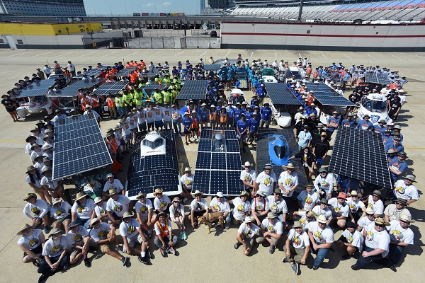
WELCOME TO THE 2018-2019 SOLAR CAR CHALLENGE

Slide 2
Why Participate in the Solar Car Challenge
Teamwork
Problem-Solving and Collaboration
Dedication and Commitment
Mechanical, Electrical Engineering, Aerodynamics, Battery Technology, Materials Technology
Power Management and Analysis

Slide 3
Learning how to deal with success and failure
Learning not to quit
Learn how to build and follow a budget
Develop speaking skills and marketing techniques
Learn special skills associated with Pi-Top laptops and Telemetry

Slide 4
What’s New
Major Workshops
New Teams
Sources – focusing on suppliers , fund raising, and using Solid Edge to prepare mechanical drawings and electrical schematics
(3) Specialty Workshop – 2 day workshop offering
more detailed solar car engineering sessions, and focusing on construction of a safe solar car
(4) Scrutineering Workshop – how to efficiently get
through the Scrutineering process

Slide 5
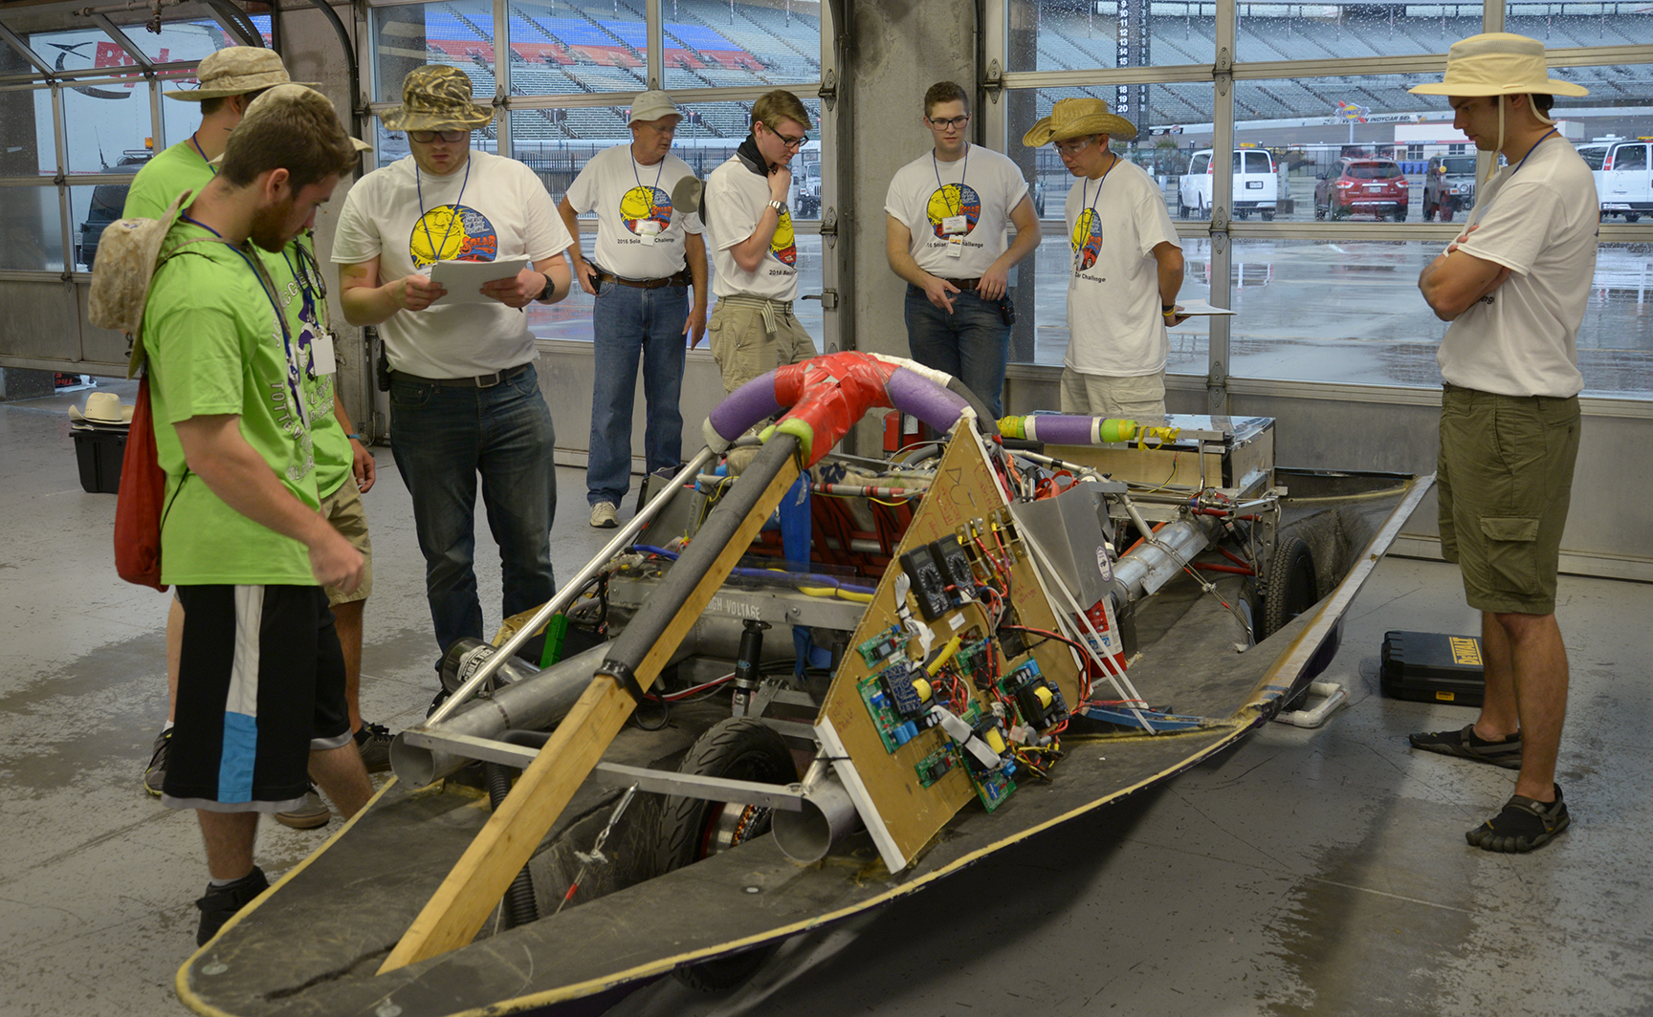
SCRUTINEERING is now a Three Day Event

Slide 6
NEW ORAL PRESENTATION Teams must make an 8-minute oral presentation setting out their project to a panel of judges. Criteria (a) Did the presentation give a full and complete statement about the team's solar car project? (b) Did all the team members participate in the presentation? (c) Did the team make its presentation without the use of notes? (d) Did the team provide visual aids? (e) Did the team scrap book adequately set out the team's progress?

Slide 7
Special Events in 2018-2019
AAA NASCAR 500 – November 3-4
solar cars will be on display and be the Pace Cars the AAA NASCAR 500
Earth Day Texas – April 27-28
solar cars will be on display & participate
in a trophy competition and “drive” at Fair Park, Dallas, Texas

Slide 8
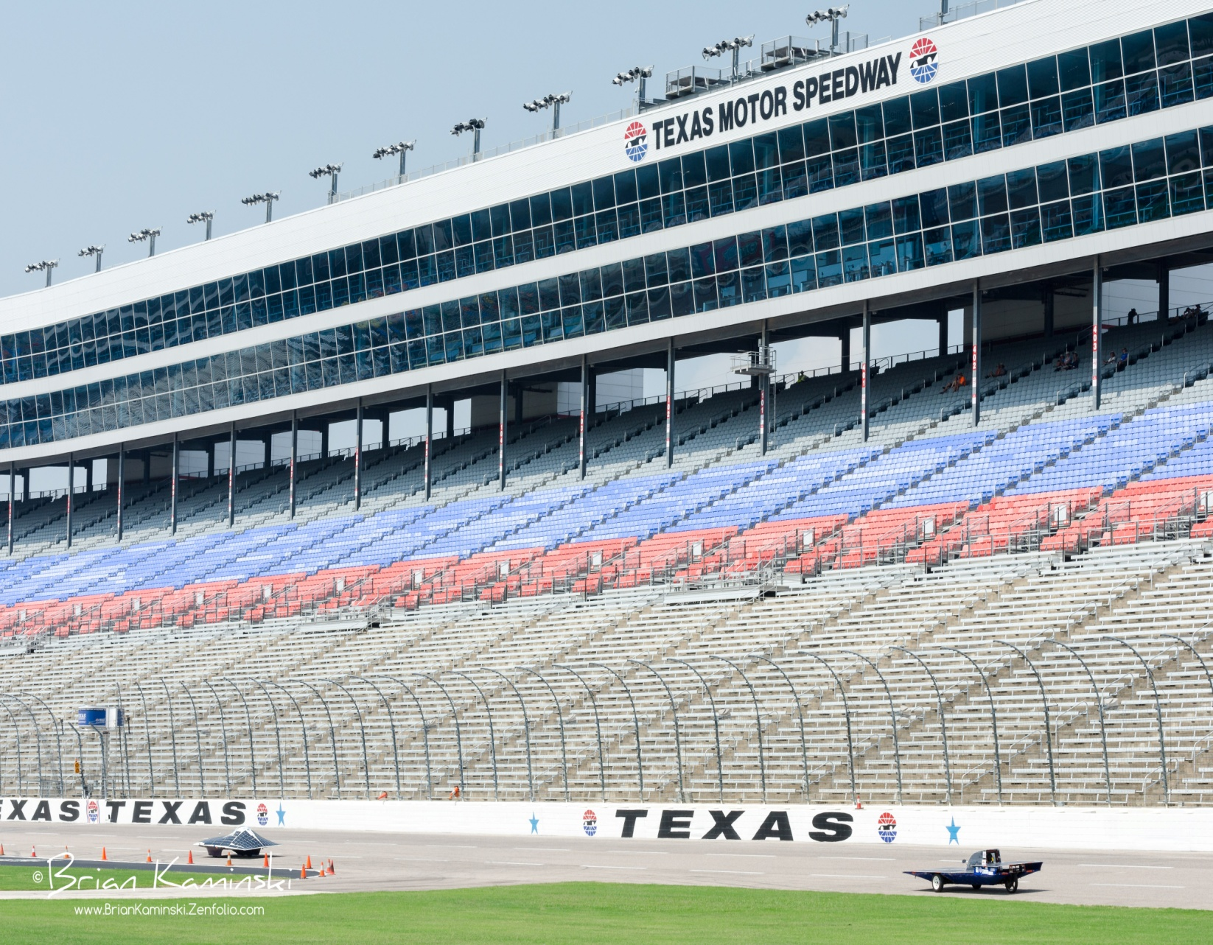
Now, it’s time to start preparing for the 2019 Solar Car Challenge

Slide 10
What is our Philosophy?

Slide 11
This is a Cooperation rather than a Competition

Slide 12
Where do we start?

Slide 13
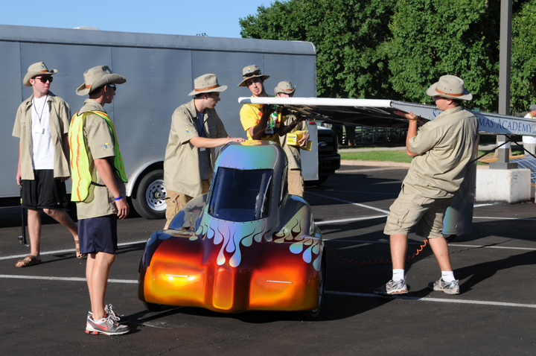
Start with Team-Building

Slide 14
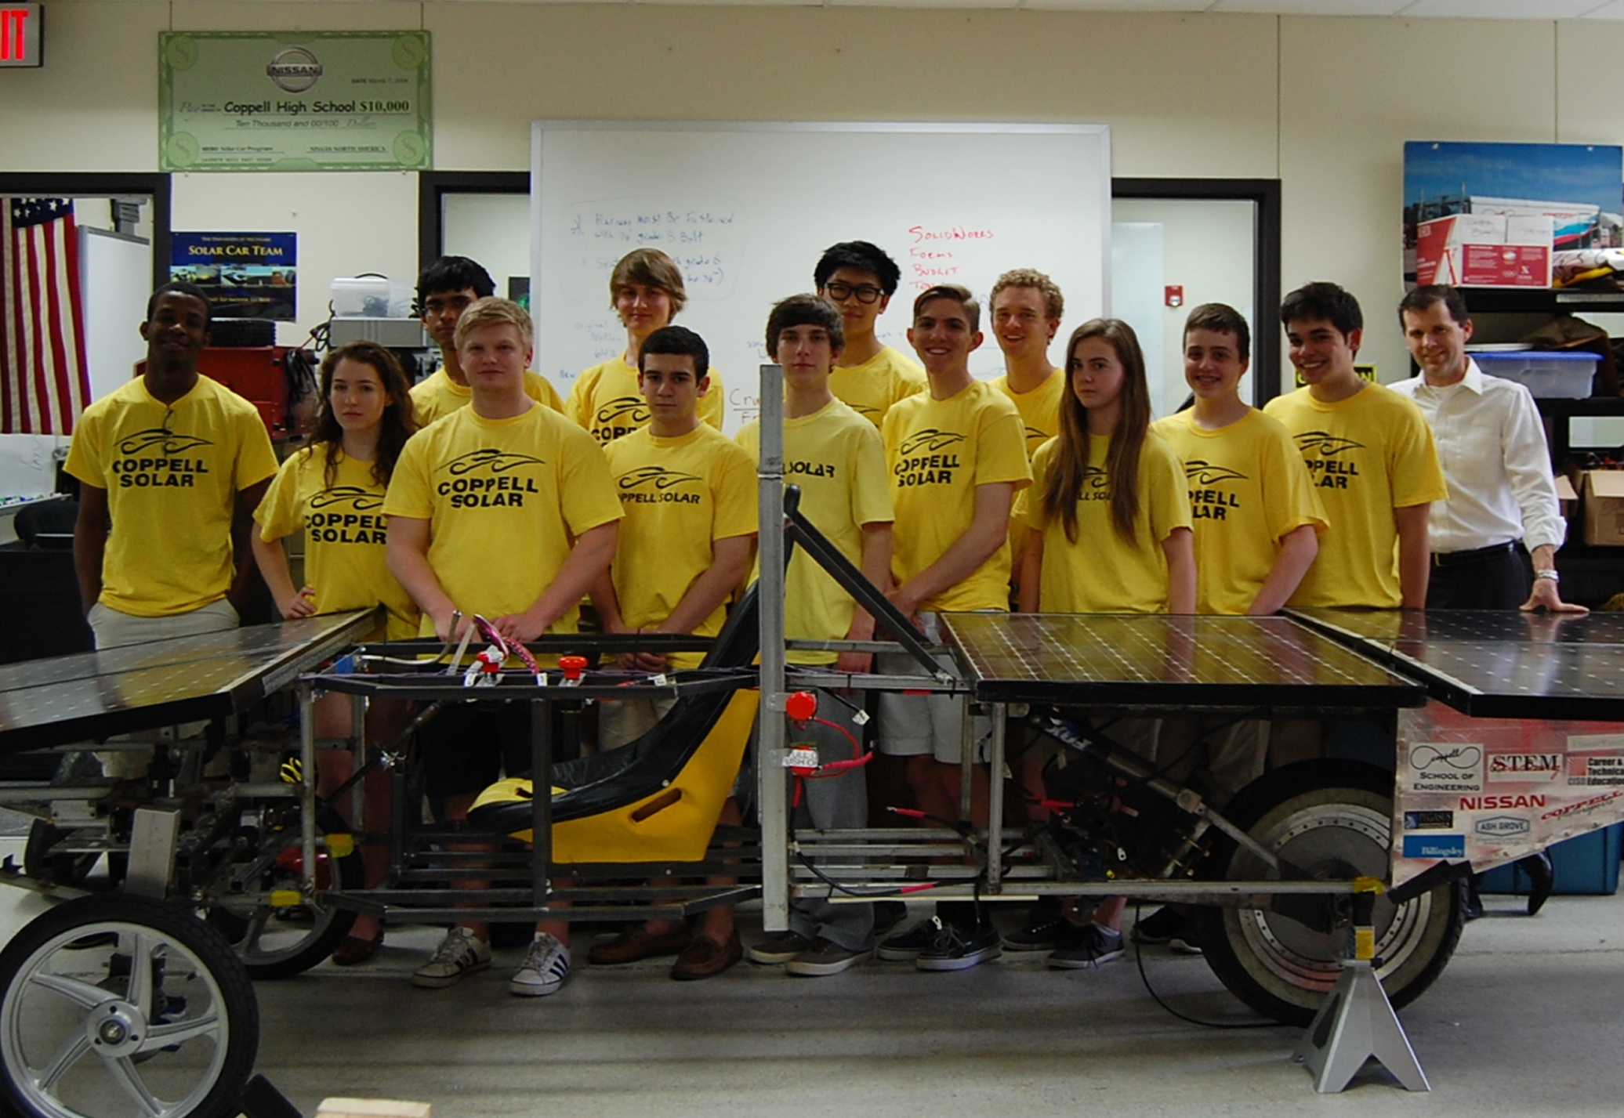
How BIG a team?

Slide 15
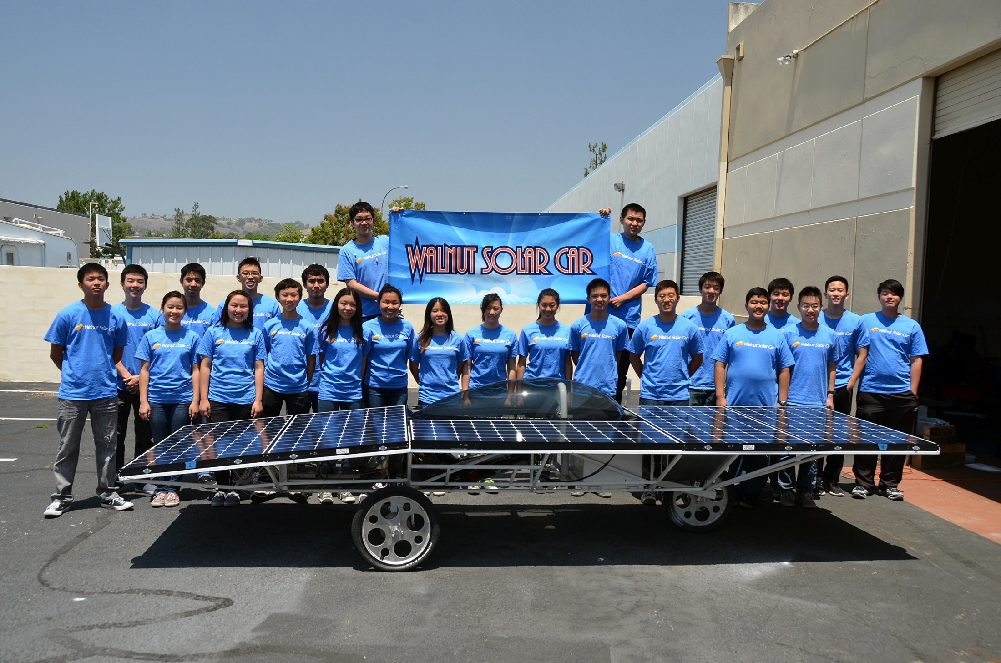

Slide 16
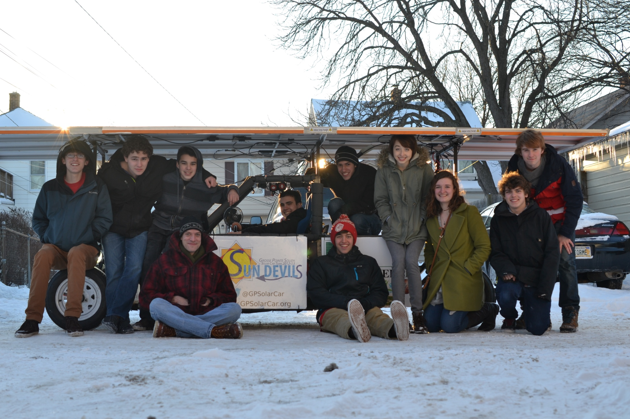

Slide 17
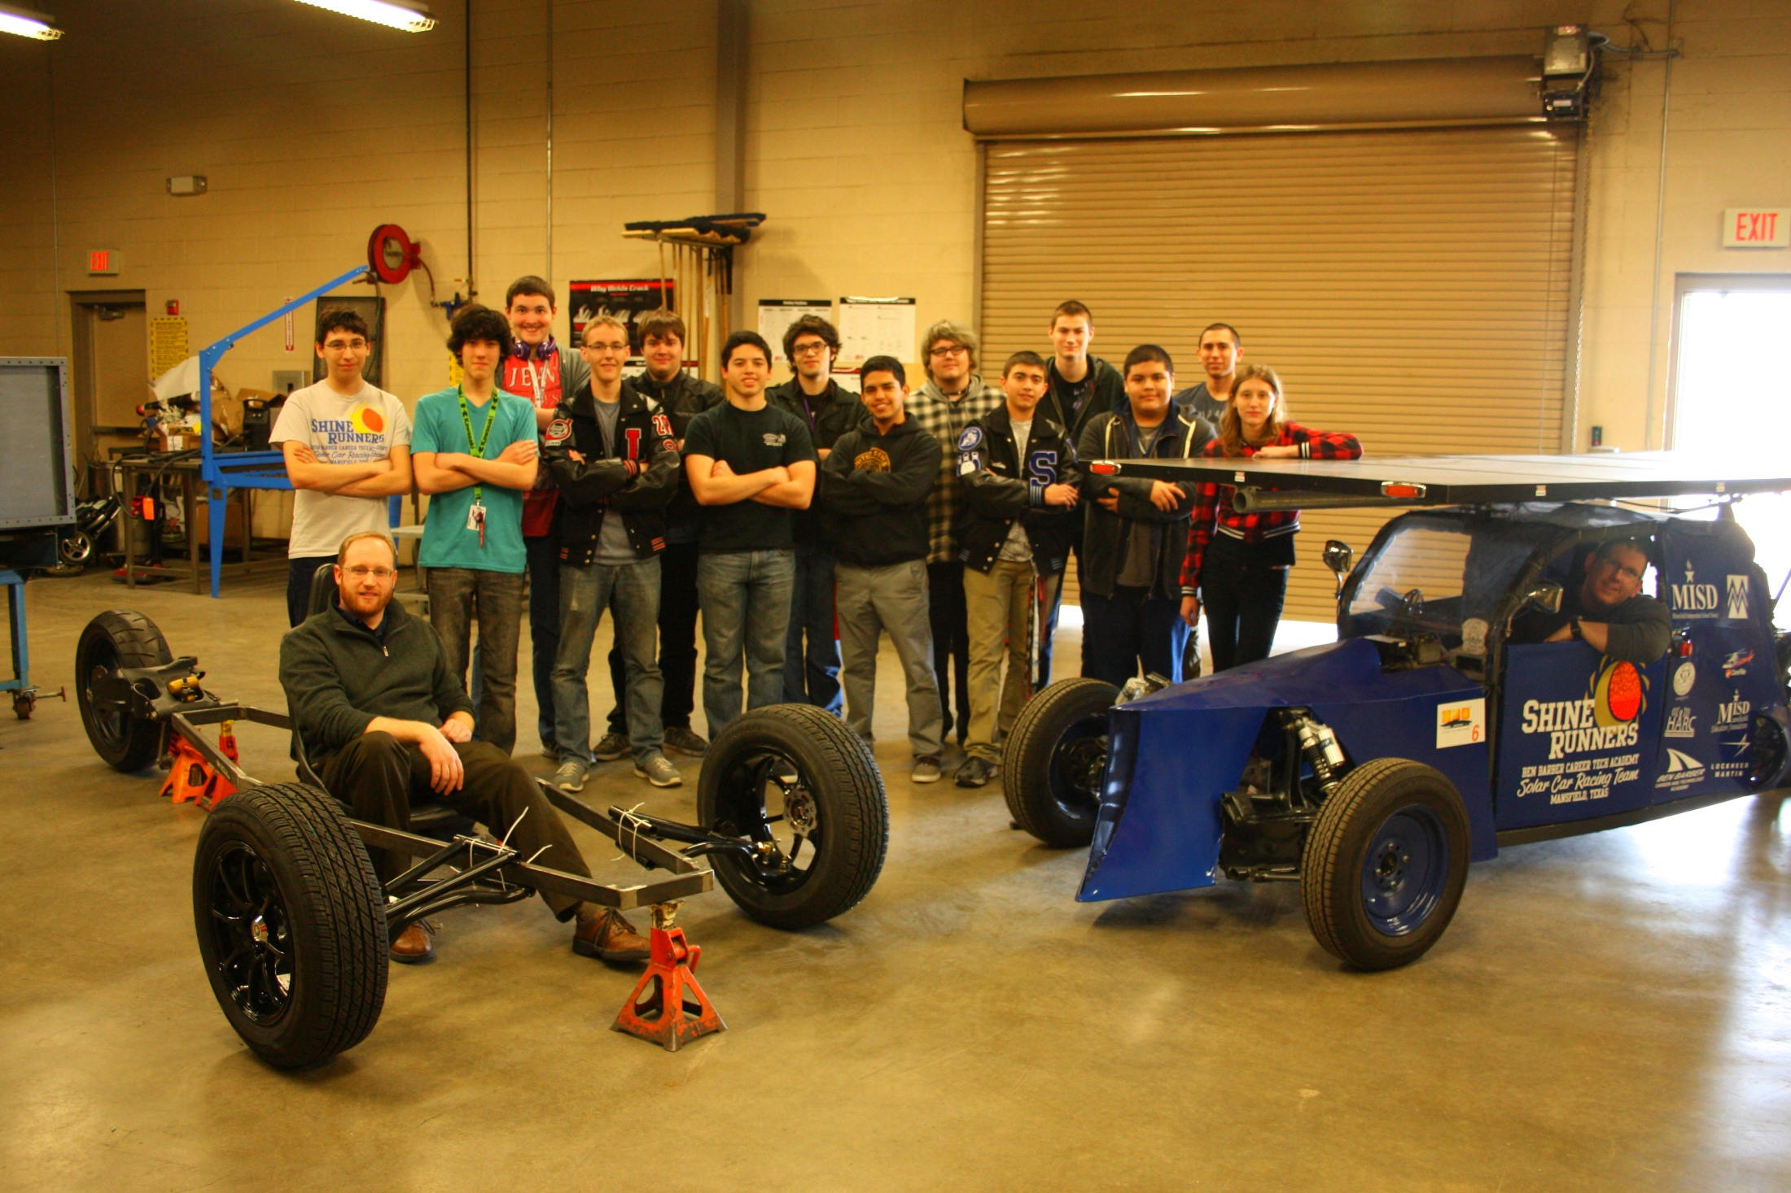

Slide 18
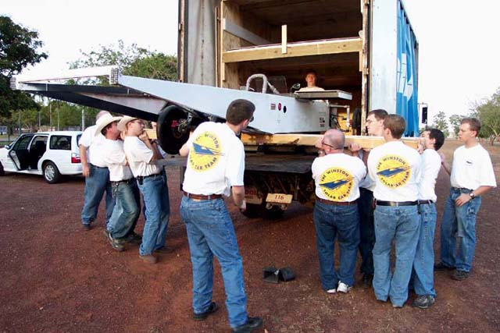
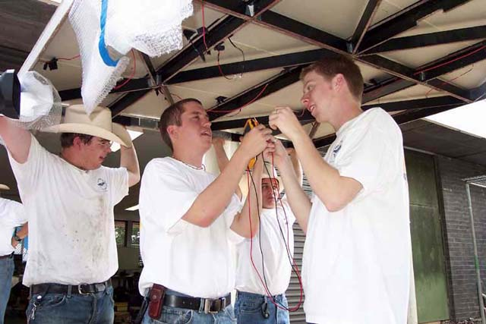
Be sure to have
enough team members to
accomplish the
task involved!

Slide 19
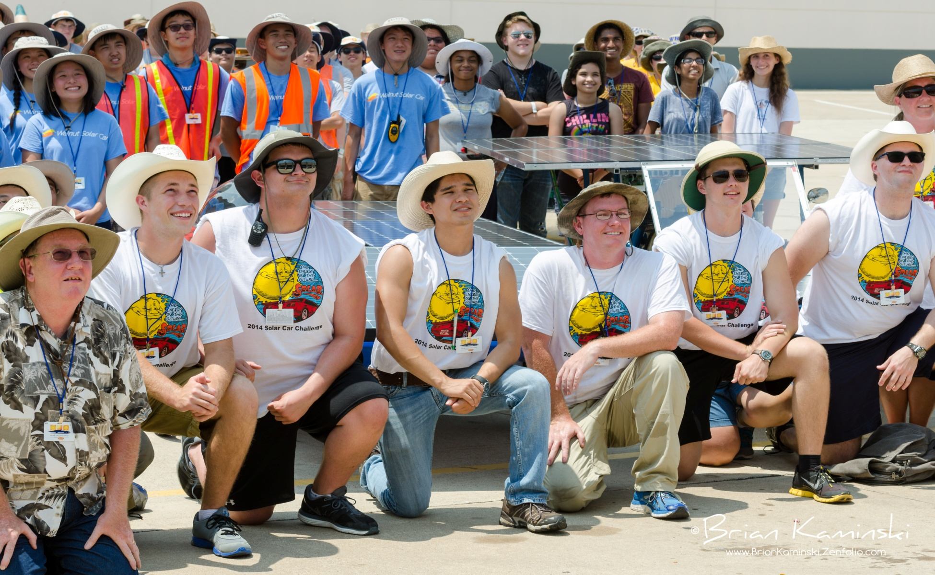
Develop the Role of Team Captain

Slide 20
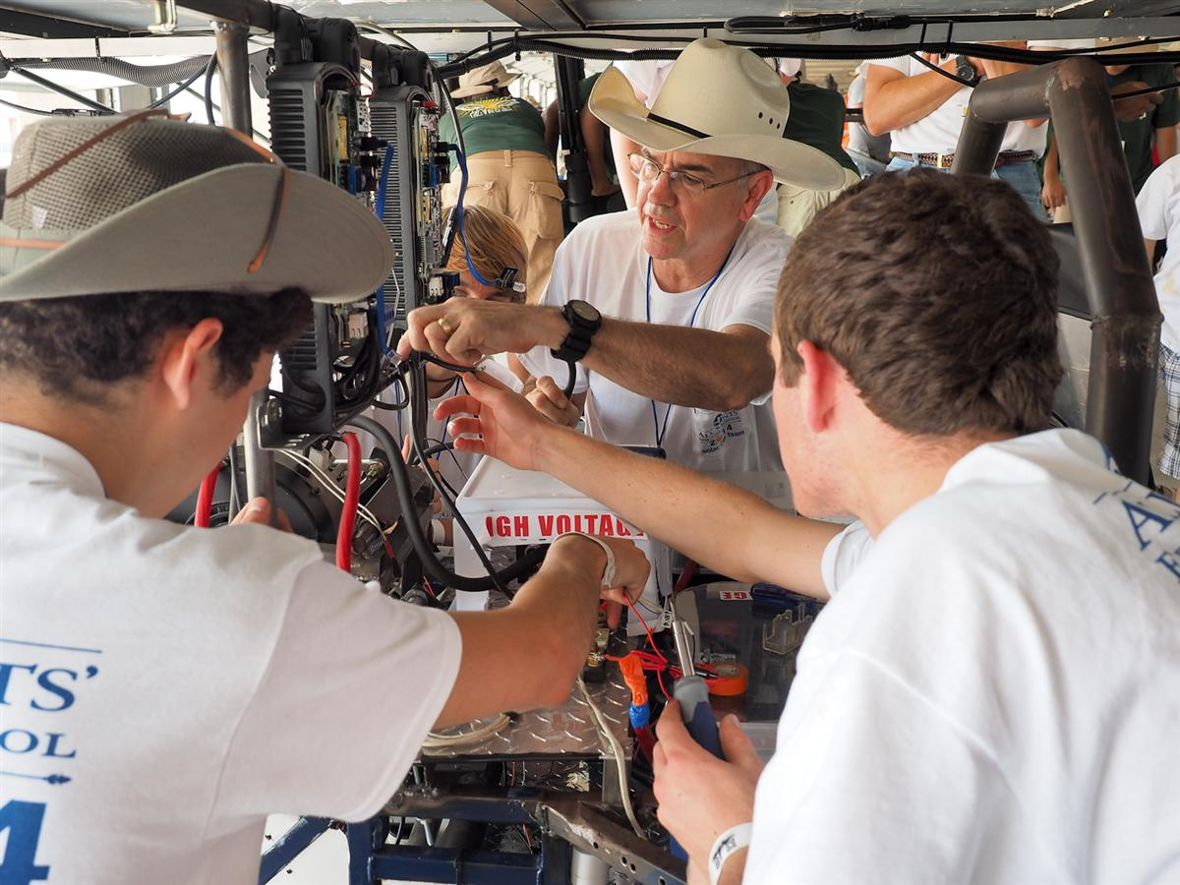
Is the team vested in the project?

Slide 21
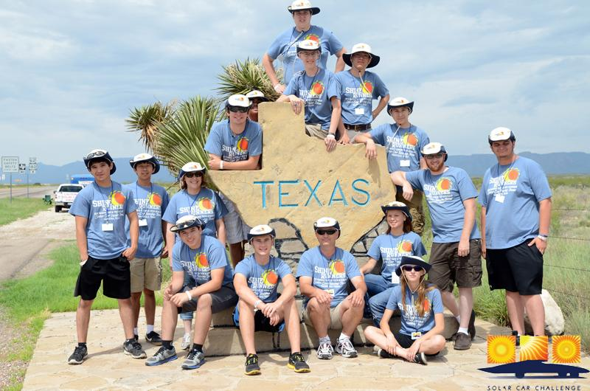
Techniques for developing long term team & parent support

Slide 22
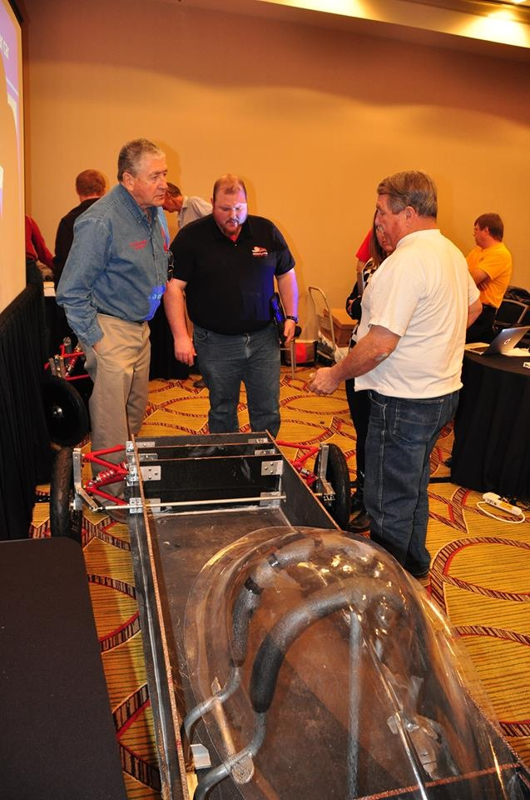
Take Advantage of Workshops
Workshops help you plan your project.
Workshops help you learn the skills to build a roadworthy solar car.
Each team finds its own solution to the problem: building a roadworthy solar car.
New Sources Workshop helps you find suppliers.
Specialty Workshop help you refine you skills and improve construction techniques.

Slide 23
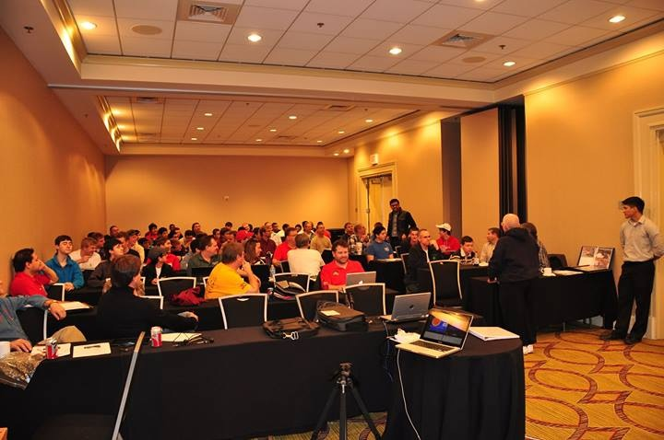

Slide 24
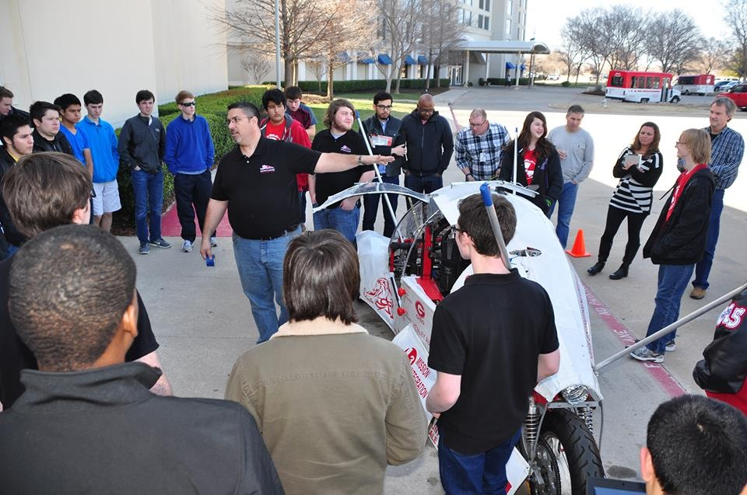

Slide 25
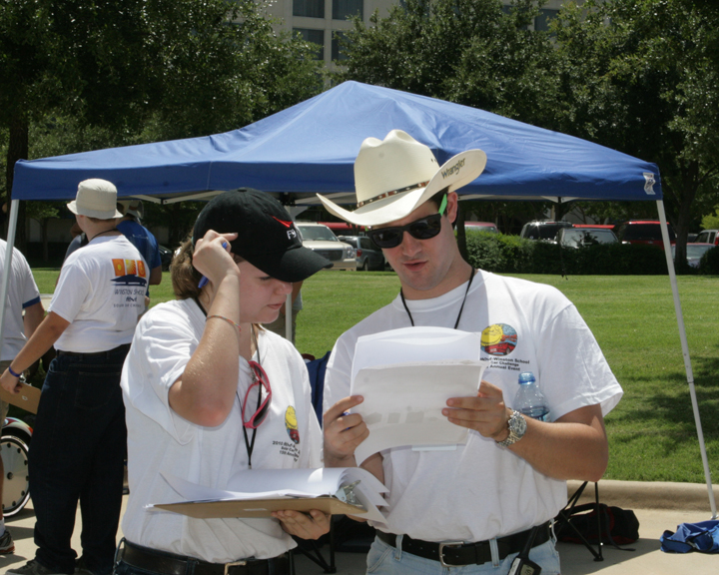
Read the Rules Together (many times)

Slide 26
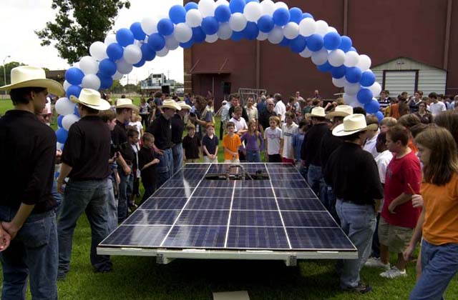
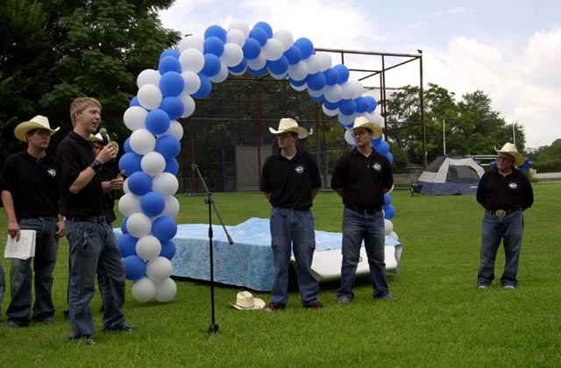
The importance of the Team being a part of fundraising

Slide 27
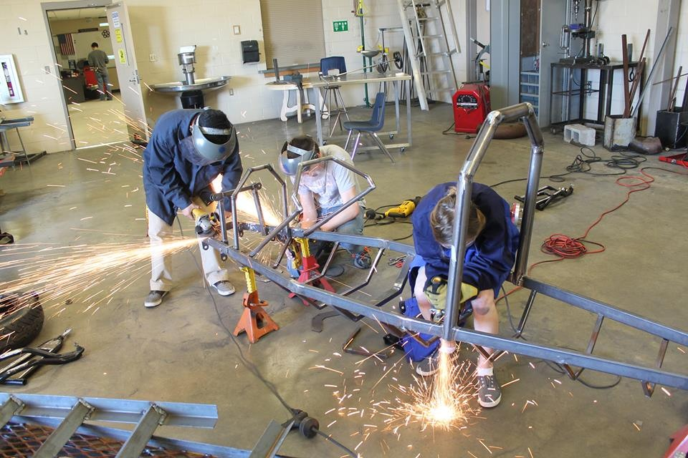
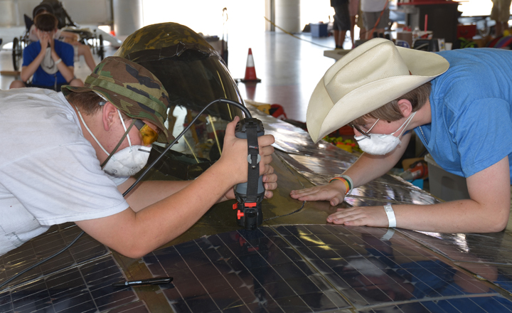
The importance of building skills

Slide 28
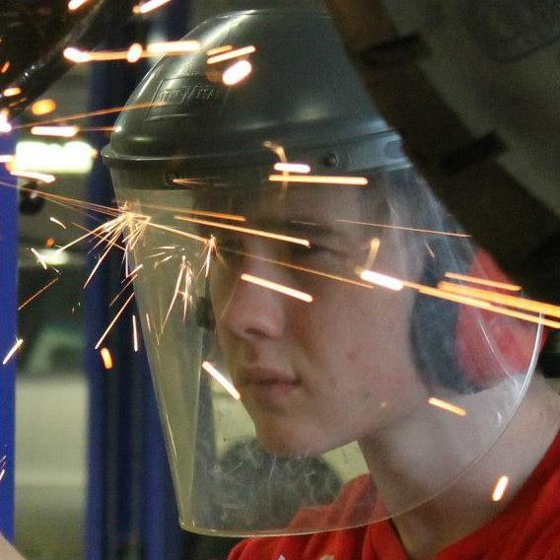

Slide 29
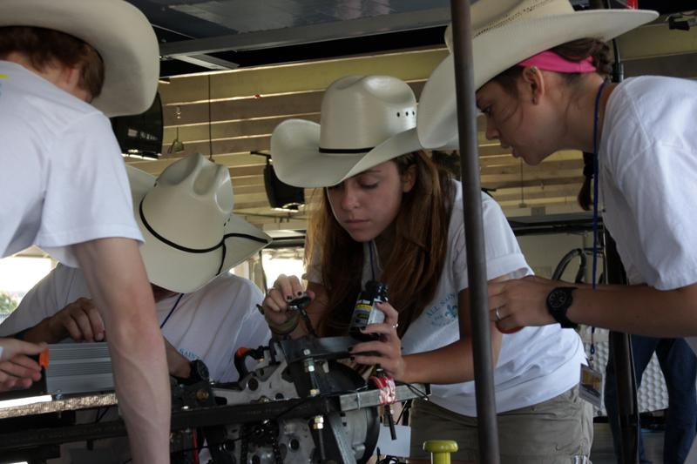

Slide 30
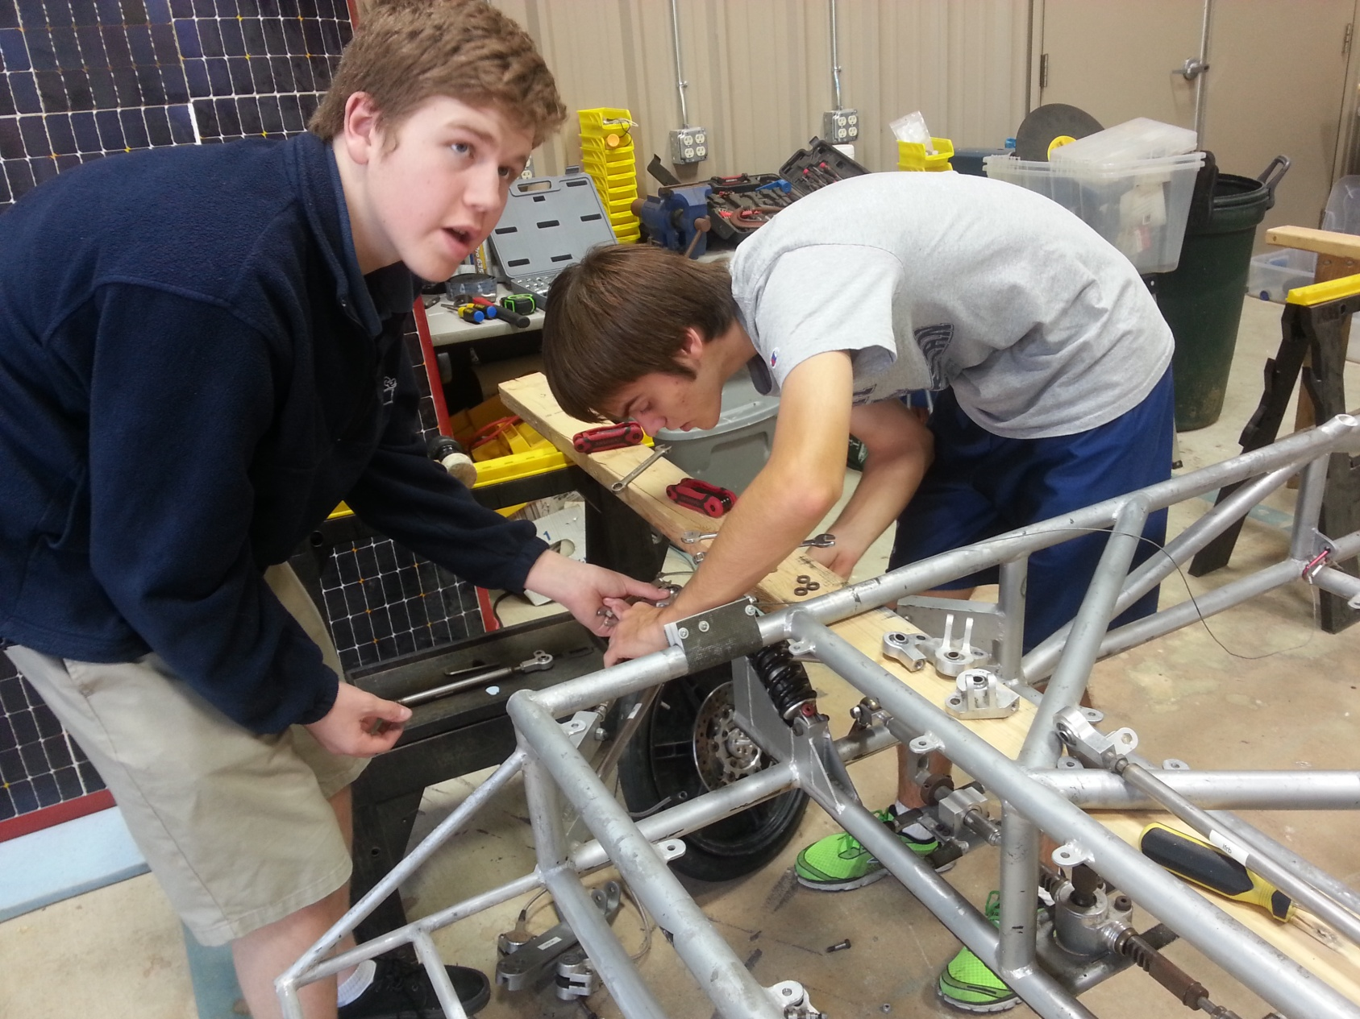
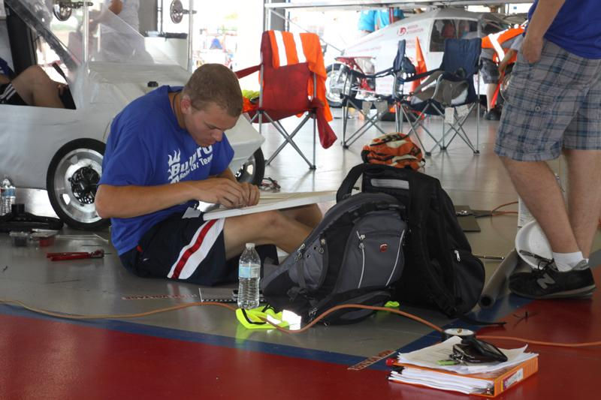

Slide 31
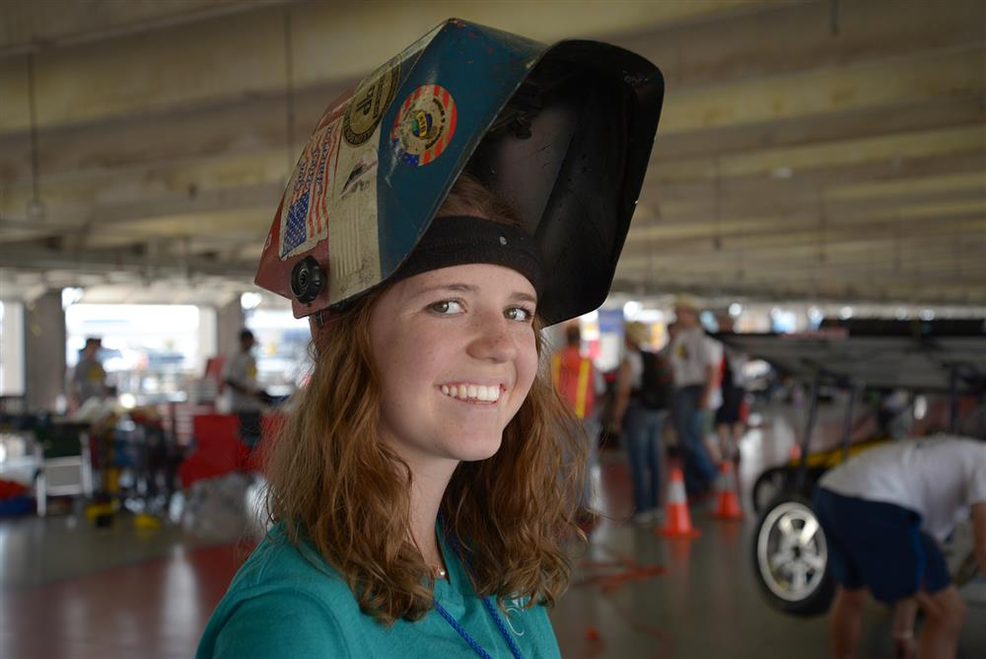

Slide 32
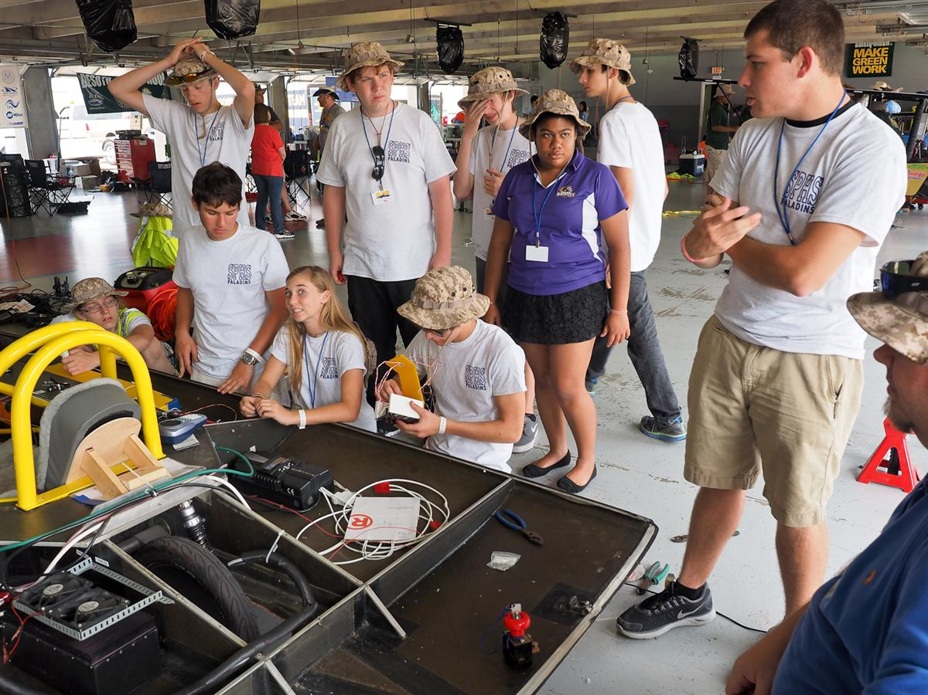
Importance of Goal-Setting and following a Timeline

Slide 33
TIMELINE
Plan Develop Fundraising Buy Build Re-Engineer Test Race Post And Promo Car Race
Design Materials Eval
____________________________________________
Sept Early Oct Oct Nov Dec - Mar Apr - May July Aug

Slide 34
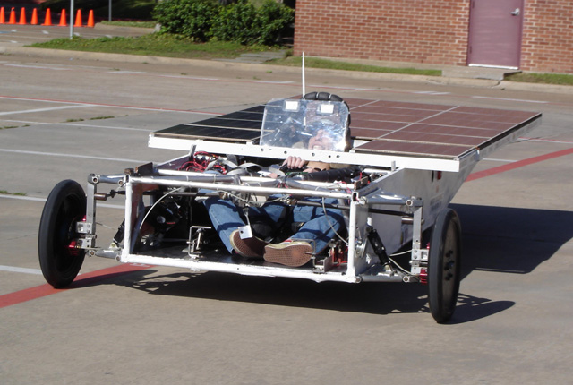
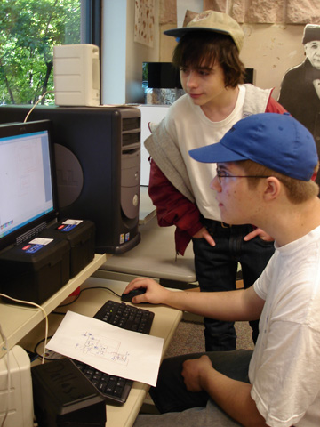
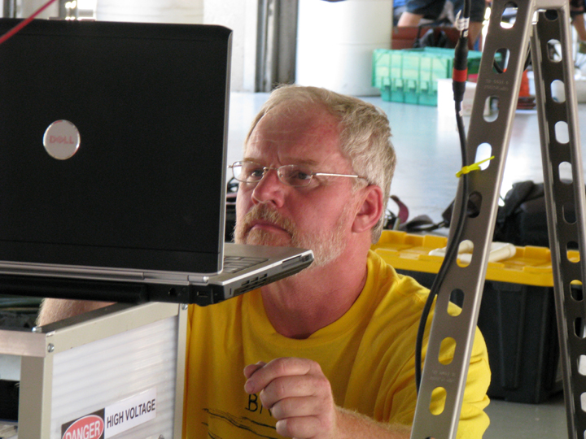
Importance of Testing

Slide 35
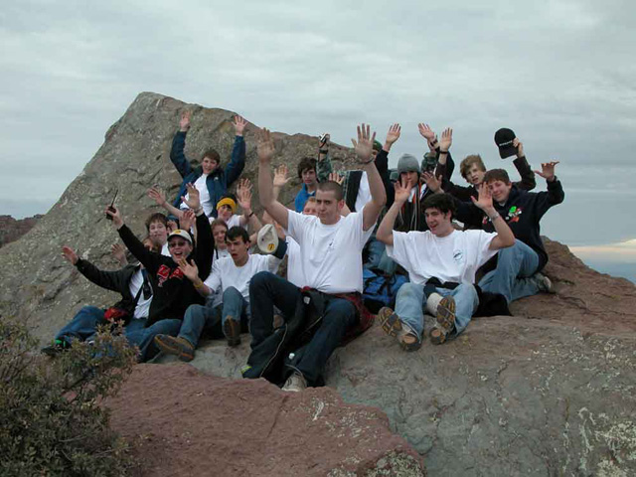
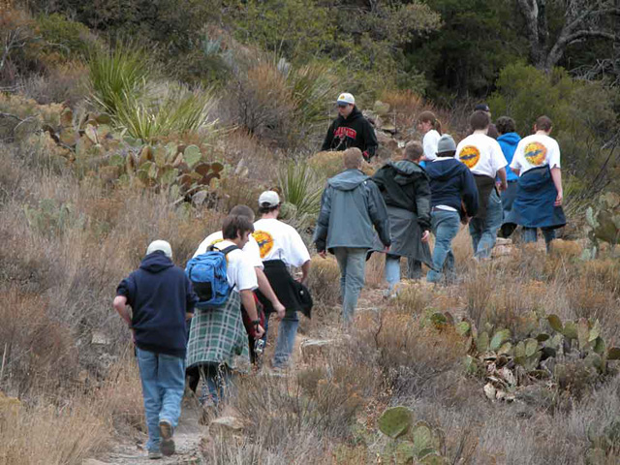
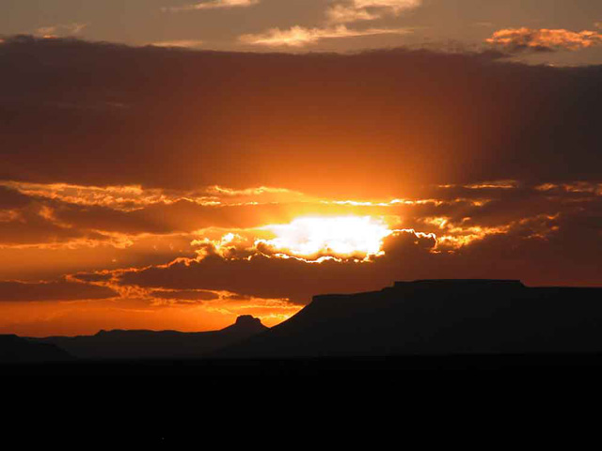
Post-Race Evaluation

Slide 36
WHY THE SOLAR CAR CHALLENGE?
Because every High School and STEM Academy needs a TOP Project for their
Project Based Learning

Slide 37
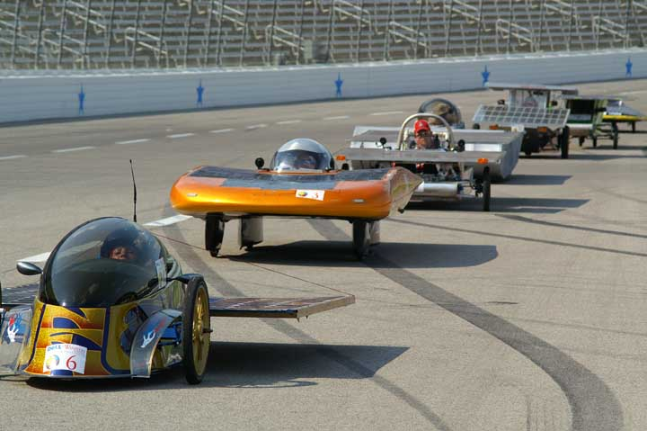
Yes, BY 23%
IS IT WORKING?

Slide 38
